Slide 1


D2N Internship

Slide 2
Introduction to CNN
Neural Networks are set of algorithms which closely resemble the human brain and are designed to recognize patterns. They interpret sensory data through a machine perception, labelling or clustering raw input. They can recognize numerical patterns, contained in vectors, into which all real-world data ( images, sound, text or time series), must be translated. Artificial neural networks are composed of a large number of highly interconnected processing elements (neuron) working together to solve a problem.
An ANN usually involves a large number of processors operating in parallel and arranged in tiers. The first tier receives the raw input information — analogous to optic nerves in human visual processing. Each successive tier receives the output from the tier preceding it, rather than from the raw input — in the same way neurons further from the optic nerve receive signals from those closer to it. The last tier produces the output of the system
A Convolutional Neural Network (CNN, or ConvNet) are a special kind of multi-layer neural networks, designed to recognize visual patterns directly from pixel images with minimal preprocessing.. The ImageNet project is a large visual database designed for use in visual object recognition software research. The ImageNet project runs an annual software contest, the ImageNet Large Scale Visual Recognition Challenge (ILSVRC), where software programs compete to correctly classify and detect objects and scenes. Here I will talk about CNN architectures of ILSVRC top competitors .

Slide 3
CNN architectures
The conventional linear structure, linear list of layers, feedforward
Generally a DAG, directed acyclic graph
ResNet simply adds back
Different terminology: complex layer and simple layer
A complex (complete) convolutional layer, including different stages such as convolution per se, batch normalization, nonlinearity, and pooling
Each stage is a layer, even there are no parameters
The traditional CNNs are just a few complex convolutional layers to extract features, then are followed by a softmax classification output layer
Convolutional networks output a high-dimensional, structured object, rather than just predicting a class label for a classiciation task or a real valuefor a regression task, it it an output tensor
S_i,j,k is the probability that pixel j,k belongs to class I
Notes:
http://cs231n.github.io/neural-networks-1/

Slide 4
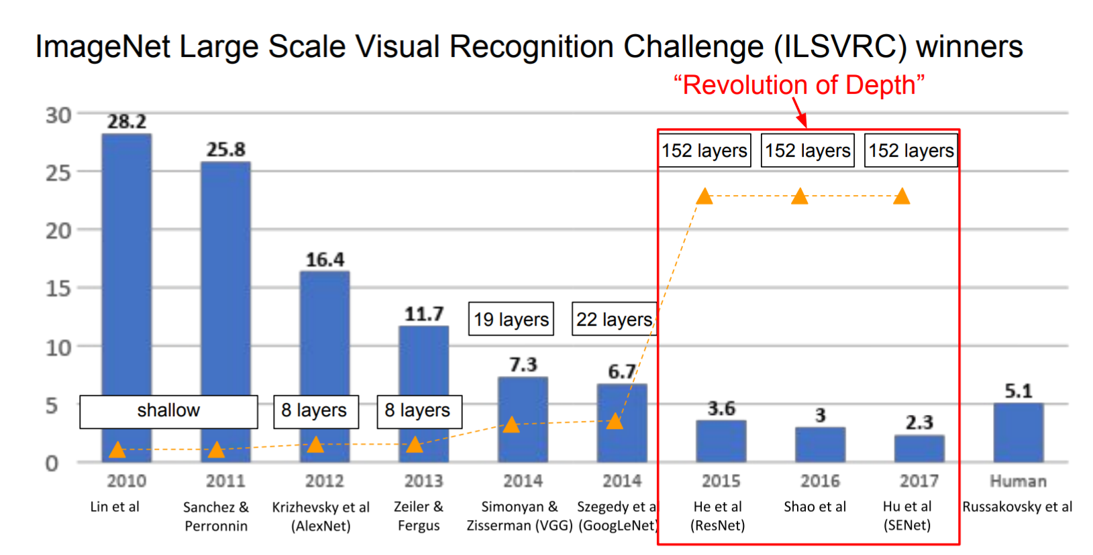
The popular CNN
LeNet, 1998
AlexNet, 2012
VGGNet, 2014
ResNet, 2015
Notes:
http://cs231n.github.io/neural-networks-1/

Slide 5
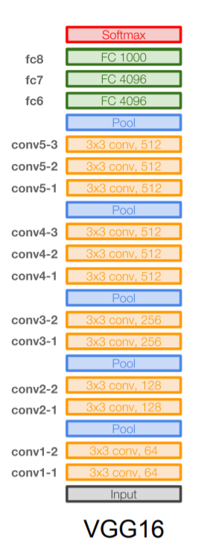
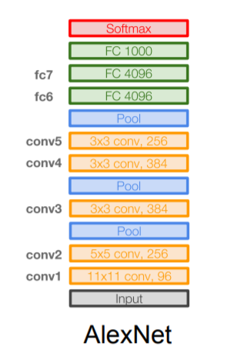
VGGNet
16 layers
Only 3*3 convolutions
138 million parameters

Slide 6
CNN applications

Slide 7
CNN applications
Transfer learning
Fine-tuning the CNN
Keep some early layers
Early layers contain more generic features, edges, color blobs
Common to many visual tasks
Fine-tune the later layers
More specific to the details of the class
CNN as feature extractor
Remove the last fully connected layer
A kind of descriptor or CNN codes for the image
AlexNet gives a 4096 Dim descriptor
Notes:
http://cs231n.github.io/neural-networks-1/

Slide 8
CNN classification/recognition nets
CNN layers and fully-connected classification layers
From ResNet to DenseNet
Densely connected
Feature concatenation
Notes:
http://cs231n.github.io/neural-networks-1/

Slide 9
Fully convolutional nets: semantic segmentation
Classification/recognition nets produce ‘non-spatial’ outputs
the last fully connected layer has the fixed dimension of classes, throws away spatial coordinates
Fully convolutional nets output maps as well
Notes:
http://cs231n.github.io/neural-networks-1/

Slide 10
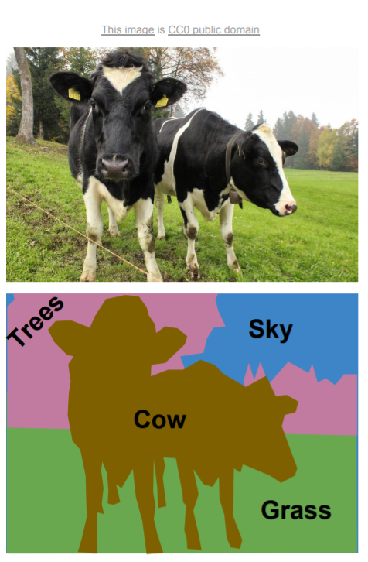
Semantic segmentation

Slide 11
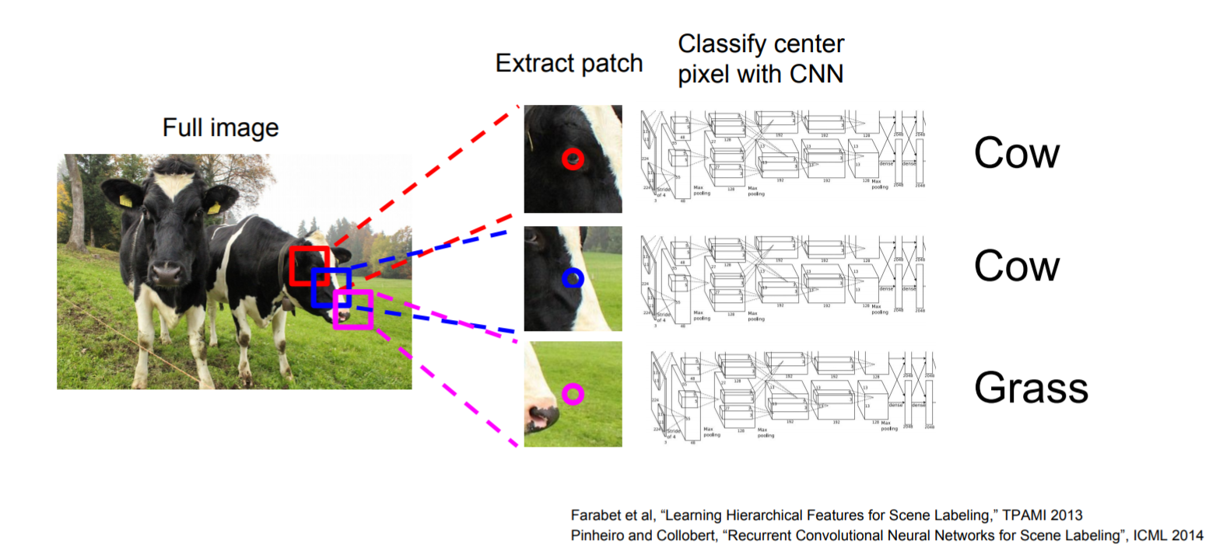
Using sliding windows for semantic segmentation

Slide 12
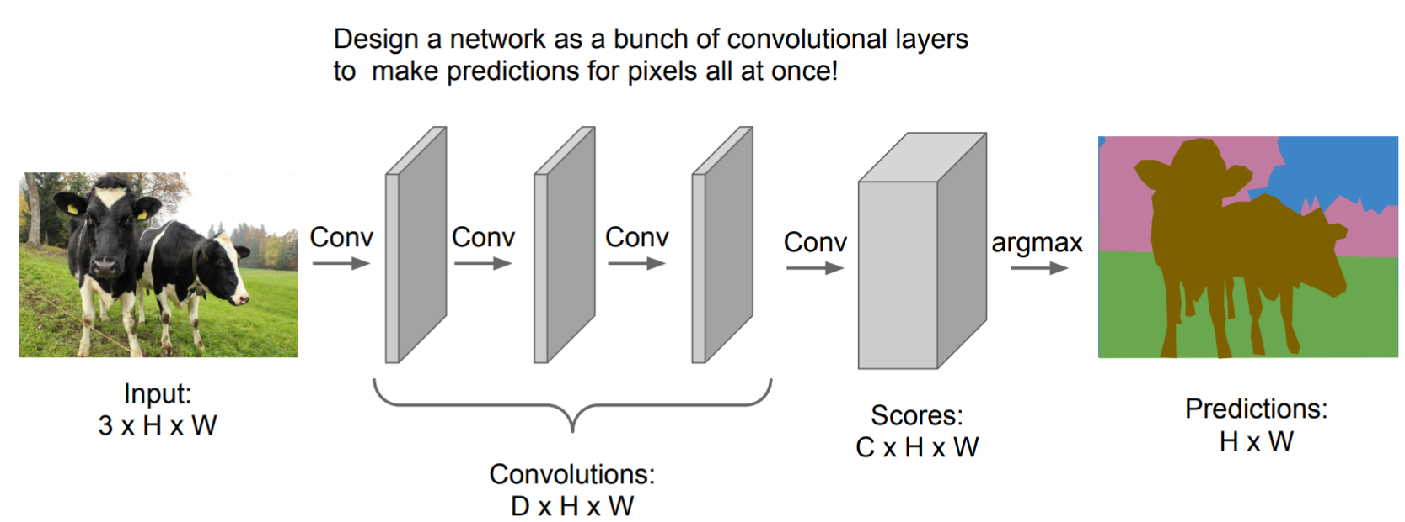
Fully convolutional

Slide 13
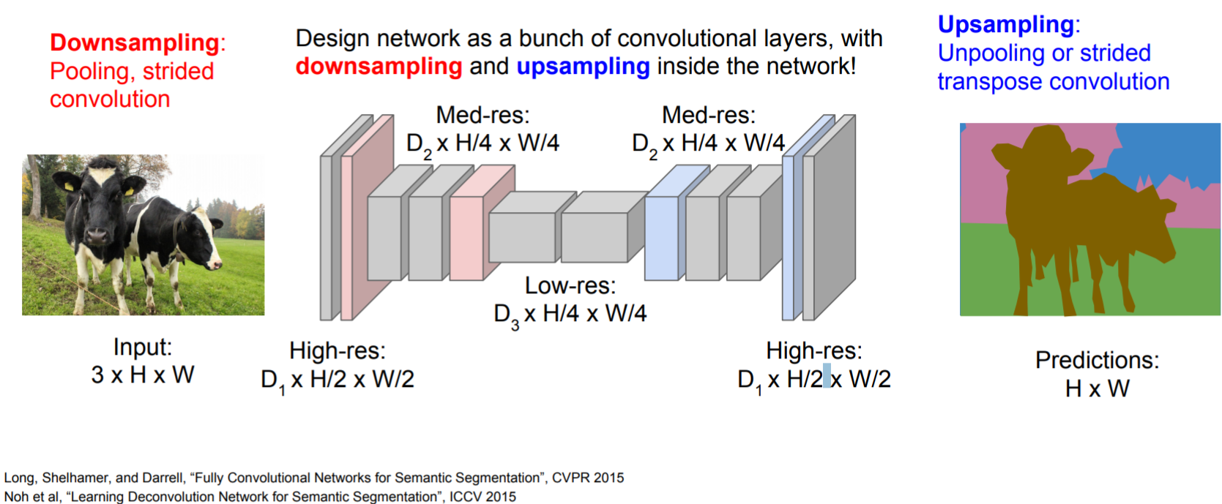
Fully convolutional

Slide 14
Detection and segmentation nets: The Mask Region-based CNN (R-CNN):
Class-independent region (bounding box) proposals
From selective search to region proposal net with objectness
Use CNN to class each region
Regression on the bounding box or contour segmentation
Mask R-CNN: end-to-end
Use CNN to make proposals on object/non-object in parallel
The old good idea of face detection by Viola
Proposal generation
Cascading (ada boosting)
Notes:
HOG features, Histogram of Gradients, by Triggs

Slide 15
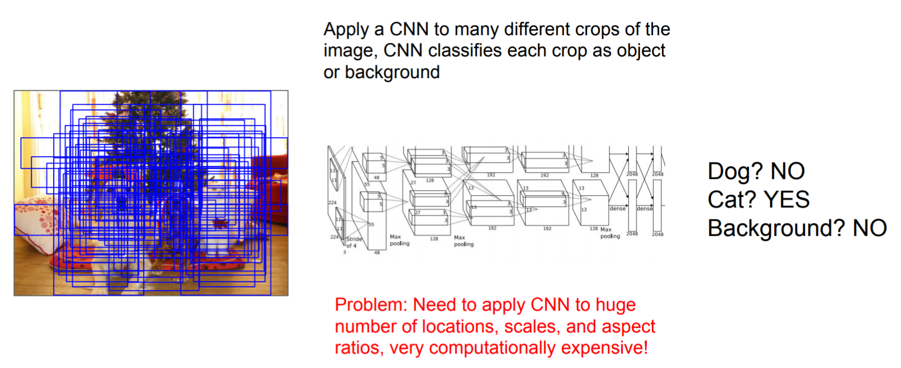
Using sliding windows for object detection as classification

Slide 16
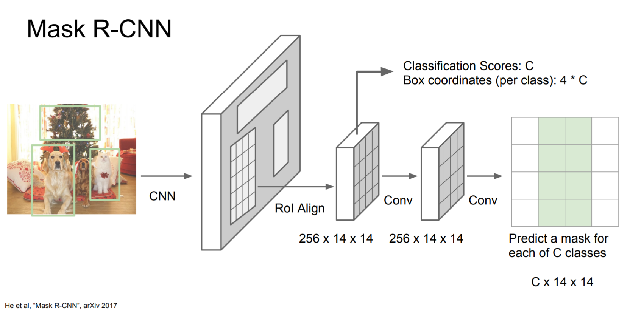
Mask R-CNN

Slide 17
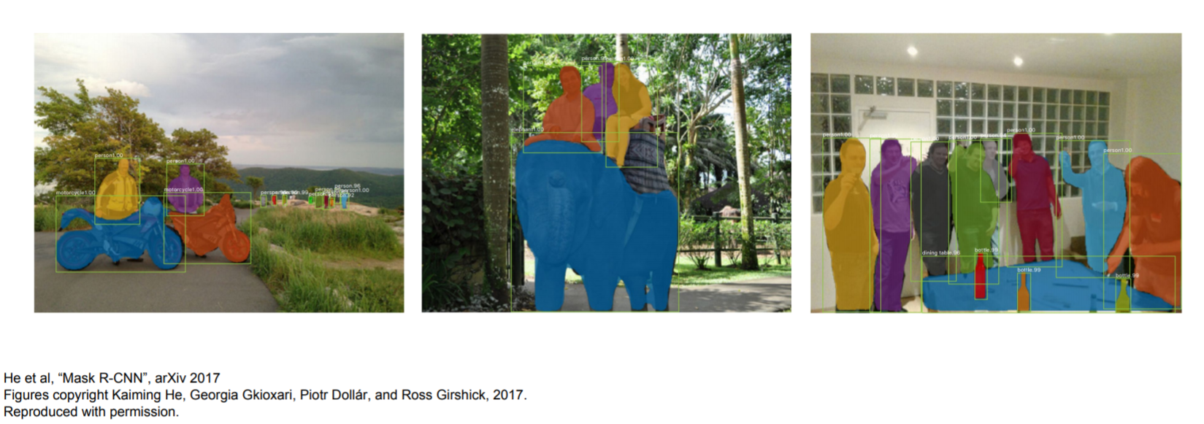
Excellent results

Slide 18
What is Recurrent Neural Network (RNN)?
Recurrent Neural Network is a generalization of feedforward neural network that has an internal memory. RNN is recurrent in nature as it performs the same function for every input of data while the output of the current input depends on the past one computation. After producing the output, it is copied and sent back into the recurrent network. For making a decision, it considers the current input and the output that it has learned from the previous input.

Slide 19
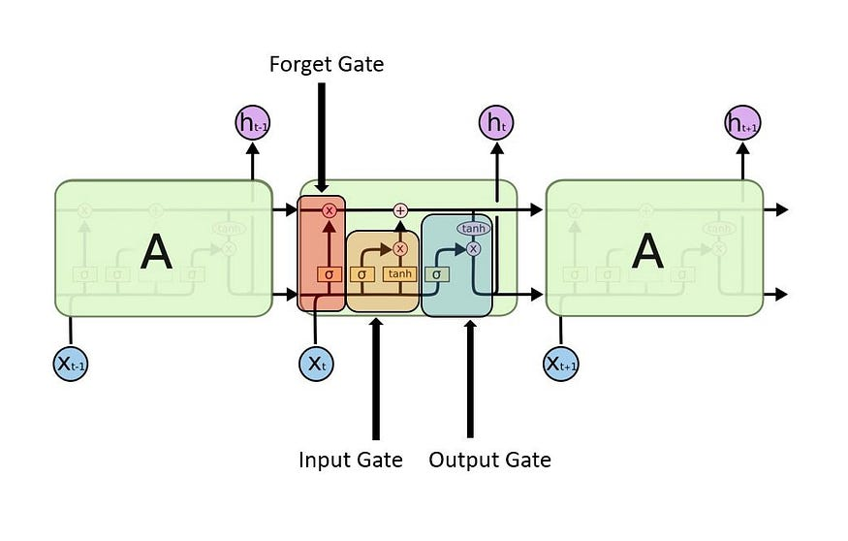
What is Long Short Term Memory (LSTM)?
Long Short-Term Memory (LSTM) networks are a modified version of recurrent neural networks, which makes it easier to remember past data in memory. The vanishing gradient problem of RNN is resolved here. LSTM is well-suited to classify, process and predict time series given time lags of unknown duration. It trains the model by using back-propagation. In an LSTM network, three gates are present:

Slide 20
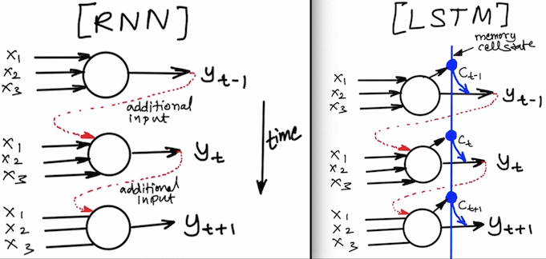

Slide 21
End.

